Slide 1
Outline
GShare - Bhavana Kurra
Local History based two level predictor - TejaSree
Perceptron predictor - Vijay
LTAGE - Rohan
ISL - TAGE - Rohith

Slide 2
Background
In 1962, the perceptron was introduced to study brain function using neural networks. We consider the simplest type of perceptron, a single-layer perceptron consisting of an artificial neuron connecting multiple input units by weighted edges to an output unit.

Slide 3
Related Work
The effortlessness of the perceptron makes it appropriate to branch expectation issues. With the short clock cycles that infest the present most progressive chip, very little calculation can be acted in the time assigned for expectation. How much particular information (history, meter readings, and so on) that can be gotten to it is likewise restricted to during this time. Thus, heavier AI methods, for example, choice trees, proliferated brain organizations, and closest neighbors are unrealistic. Nonetheless, perceptrons can be prepared with a basic update rule and can settle on momentary choices to make a few increments. They are also contenders for pipelining.

Slide 4
Neural Networks:
An artificial neural network learns how to compute a function using example inputs and outputs. Neural networks have been used for a variety of applications including pattern recognition, classification, and image understanding.

Slide 5
Perceptrons
Perceptron is a tool developed in Machine Learning as a straightforward model of human neuron. The perceptron takes a bunch of information signals x and duplicates each sign by the weighted set w of the perceptron. Then, at that point, it adds the outcomes and presentations 1 assuming the total is ³0 and - 1 in any case.
For branch prediction, the input to the perceptron is usually the global history of branch outcomes, and semantically, the output is “Taken” if the sum is 0 and “not taken” if the sum is <0.

Slide 6
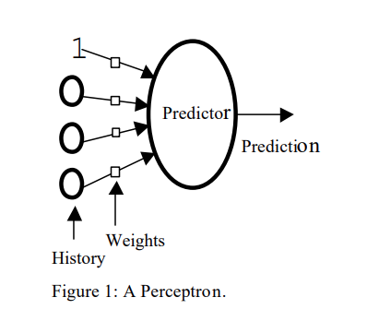
A sample perceptron figure:

Slide 7
Types of Branch Predictors that uses Neural Networks:
There are two different types of branch predictors that uses Neural Networks.
They are
Static Branch Prediction with neural networks
Dynamic Branch prediction with Neural networks.

Slide 8
Perceptron Predictor:
The perceptron predictor uses a simple neural network, the perceptron instead of a two-bit counter. It learns a target boolean function input f(x1, x2,…, xn) to predict whether a particular branch will be used.
These x are the bits of the global branch history shift register. x is bipolar, −1 represents the untaken result, and 1 represents the obtained result. A perceptron is represented as a weighted vector w0, w1,…, wn.
Here, the weights are signed integers. The output is calculated as the dot product of the weight vectors w0, w1,…, wn and the input vectors x0, x1,…, xn (x0 gives a biased input and is always set to 1). The y output of a perceptron is: y=w0+∑ni=1wi∗xi

Slide 9
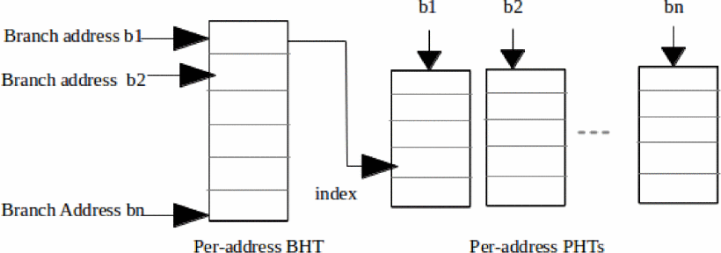
Block diagram of a perceptron predictor internals.

Slide 10
Training Perceptrons
once the output of the perceptron has been computed there, the following algorithm is used to train the perceptron. Let t be -1 if the branch was not taken, or 1 if it was taken, and let θ be the threshold, a parameter to the training algorithm used to decide when enough training has been done
Since t and x are in every case either - 1 or 1, this calculation increases the I weight when the branch result concurs with xi, and decrements the weight when it clashes.

Slide 11
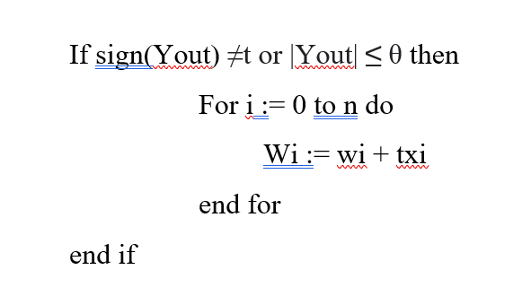
Training Perceptrons

Slide 12
Methodology:
Perceptron is used to find out the correlation between the results of a particular branch in global history and the behavior of the current branch. These correlations are represented by weights. The higher the weight, the stronger the correlation, and the more specific branches of the overall history contribute to the prediction of the current branch.

Slide 13
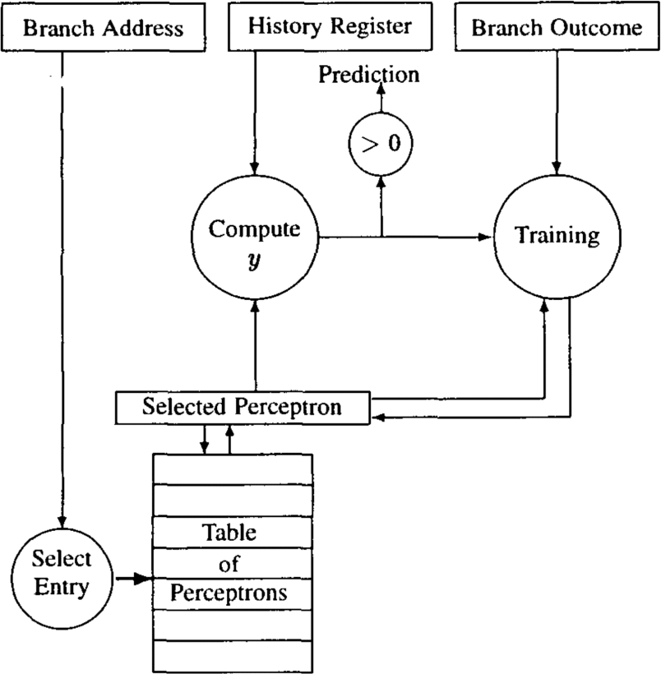
Block diagram for the perceptron predictor:

Slide 14
Predictors Simulated:
We contrast our new predicator with gshare and bimode, two of the best completely powerful predictors worldwide in the branch prediction literature.
We are additionally assessing a joined gshare/perceptron predictor that utilizes a 2K-byte determination table and a similar selection mechanism as in Alpha 21264.
The motivation behind our joined indicator is to show that since the perceptron has extra qualities to gshare, a blend of the two functions admirably.

Slide 15
Tuning the predictors:
We use a composite trace of the initial 10 million parts of every SPEC 2000 benchmark to tune the boundaries of every predictor for a variety of hardware budgets.
For gshare and bi-mode, we tune the history lengths by exhaustively trying every possible history length for each hardware budget, keeping the value that gives the best prediction accuracy.
For the perceptron predictor, we find, for each history length, the best value of the threshold by using an intelligent search of the space of values, pruning areas of the space that give poor performance.

Slide 16
Performance
The harmonized means of prediction rates are obtained with increasing hardware budgets on the SPEC 2000 benchmarks. The advantage of the perceptron predictor over PHT methods is greatest with a hardware budget of 4K bytes. , where the perceptron predictor had a prediction error rate of 6.89%, a 10.1% improvement over gshare and 8.2% over dual mode. For comparison, the bi-mode predictor improved only 2.1% over the 4K budget share. Interestingly, overall, SPEC 2000's integer benchmark is easier for branch predictions than SPEC95's benchmark, explaining the smaller split between gshare and bimode compared to the previously observed.

Slide 17
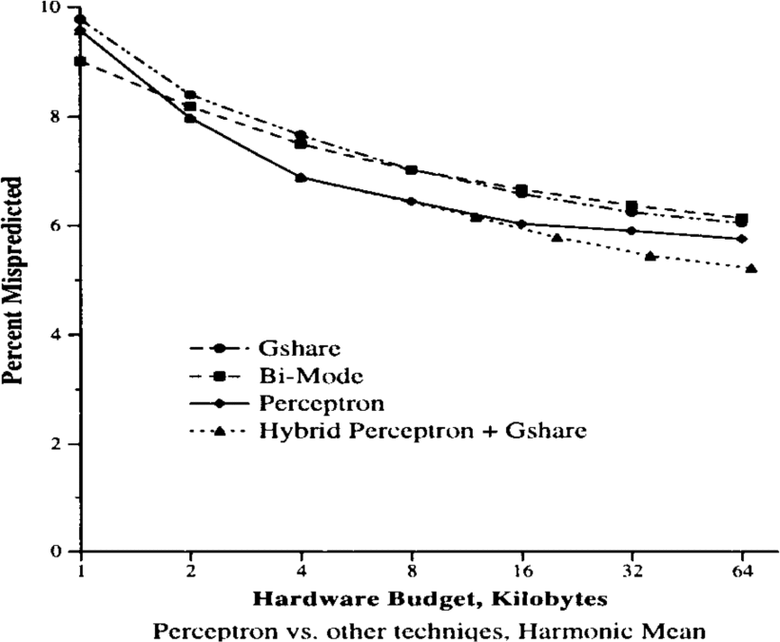
Perceptrons Performance

Slide 18
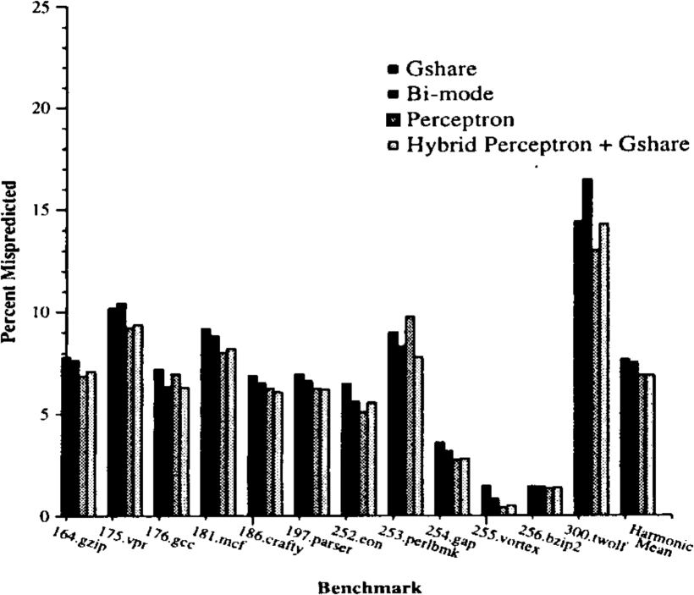
Training Times

Slide 19
Advantages and Disadvantages:
Limitations:
The output values ​​of a perceptron can only take one of two values ​​(0 or 1) due to the hardlimit transfer function.
perceptron can only classify the set of linearly separable vectors.
Advantages:
A key benefit of our methodology is its capacity to use long branch history lengths.

